Slide 1

Build a LIVE Web site in 5 minutes
Robert Dattolo
Founder, Concise CS, LLC

Slide 2
The tools
GitHub – for hosting (storing) the site
OpenAI ChatGPT – for building the site’s code
Custom Domain – optional name (example.com)
At the end of the presentation
GitHub Professional - Students (FREE)

Slide 3


Github.com github.io

Slide 4
Github.com free professional accounts
FREE for students
Use your @macomb.edu email when signing up @ GitHub

Slide 5
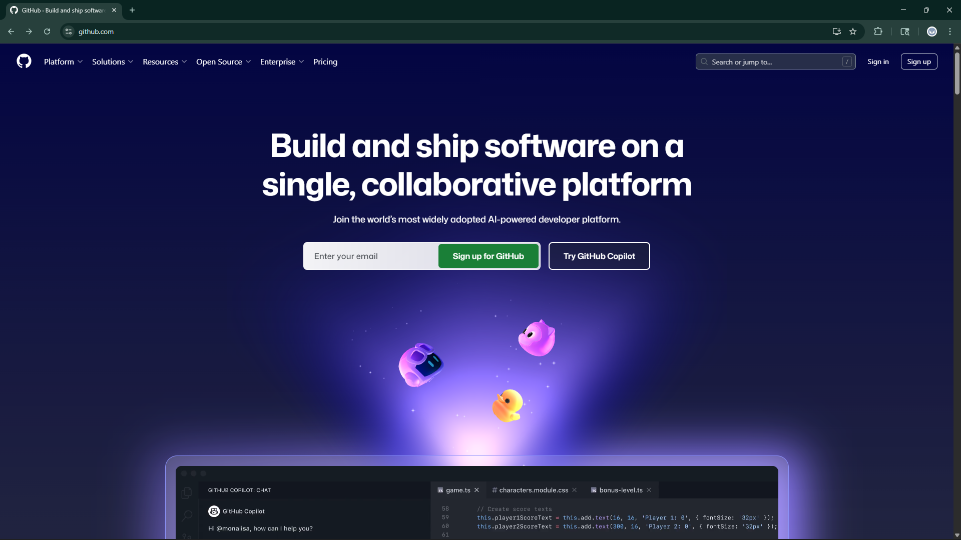


Slide 6
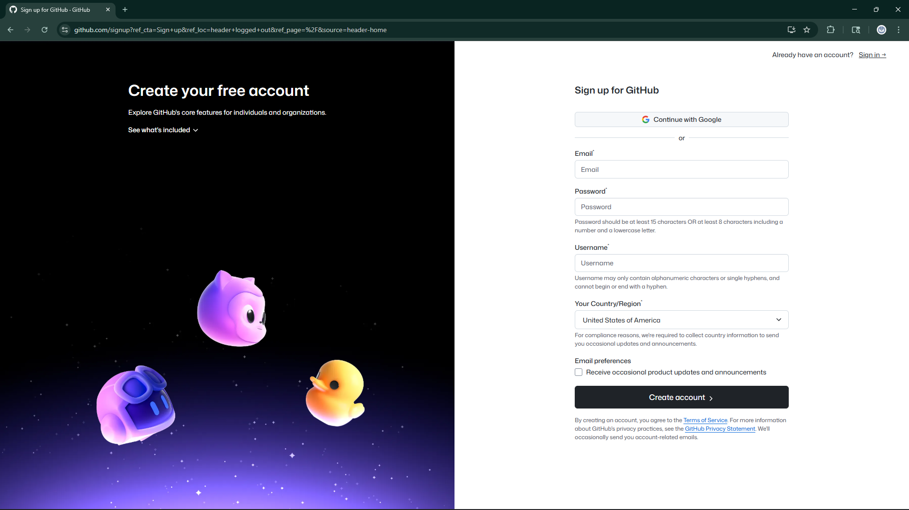


Slide 7
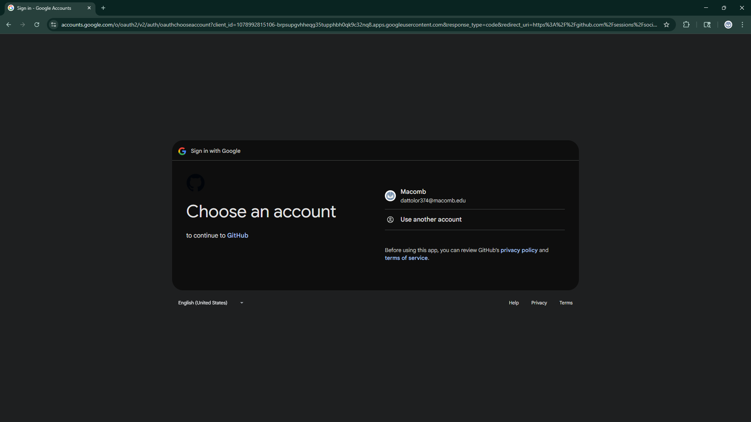

Slide 8
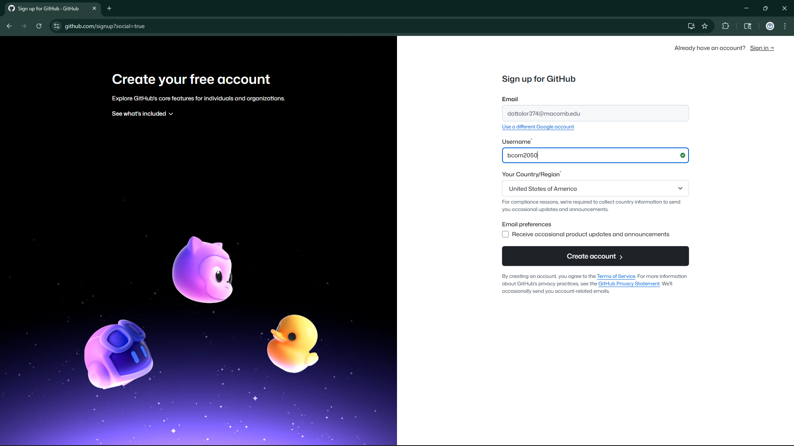

Slide 9
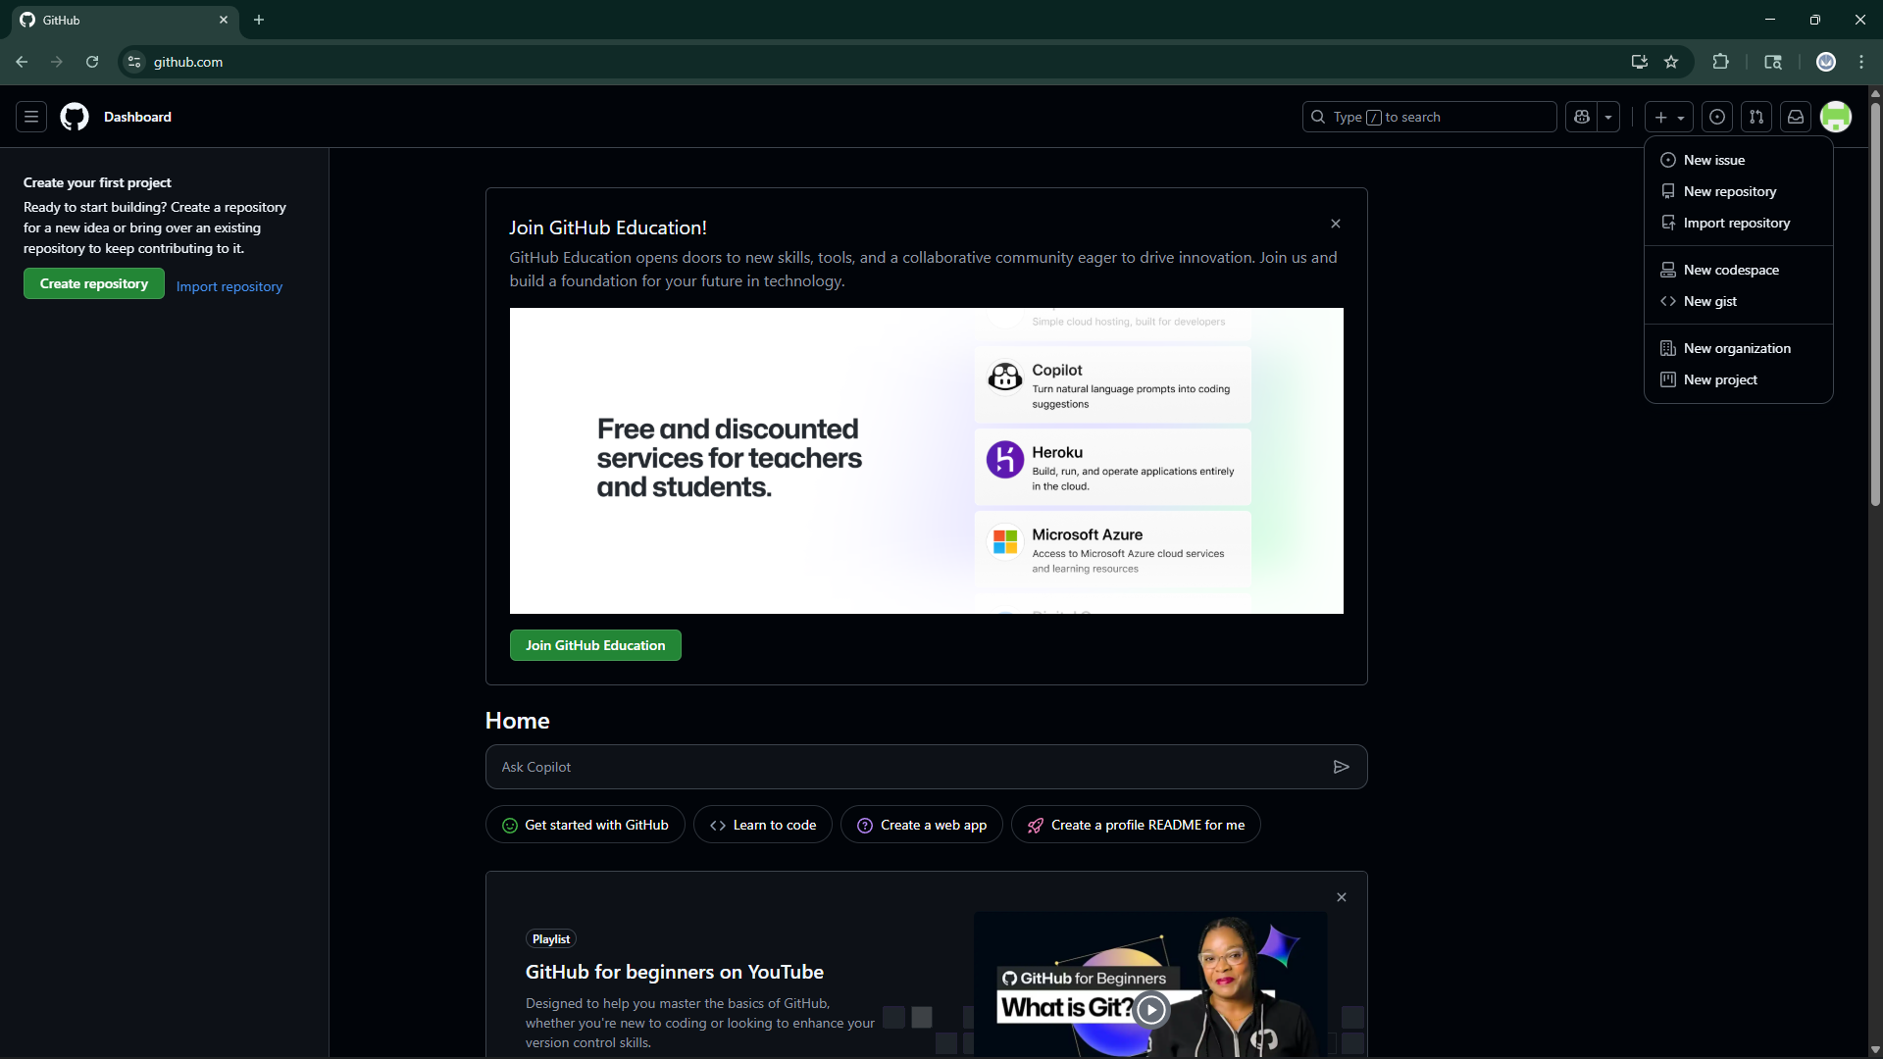

Slide 10
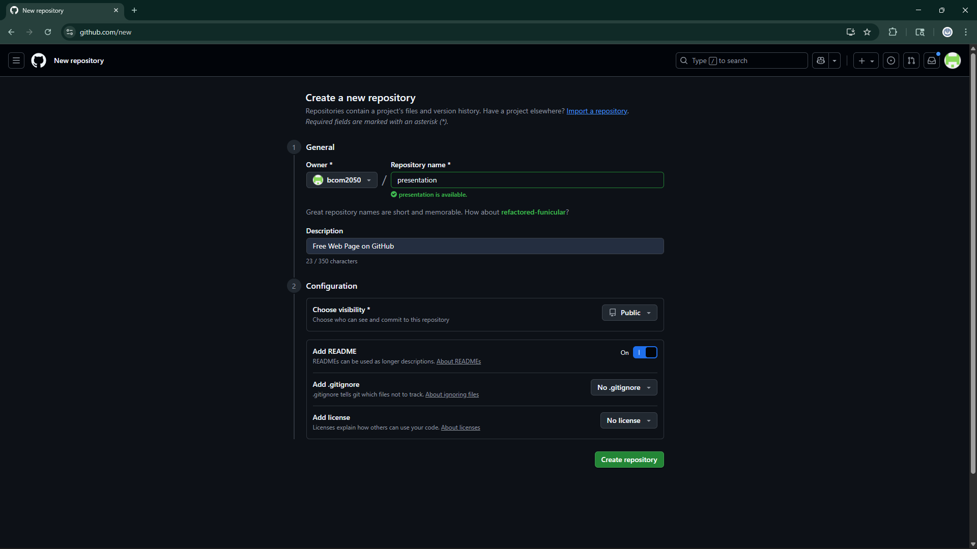

Slide 11
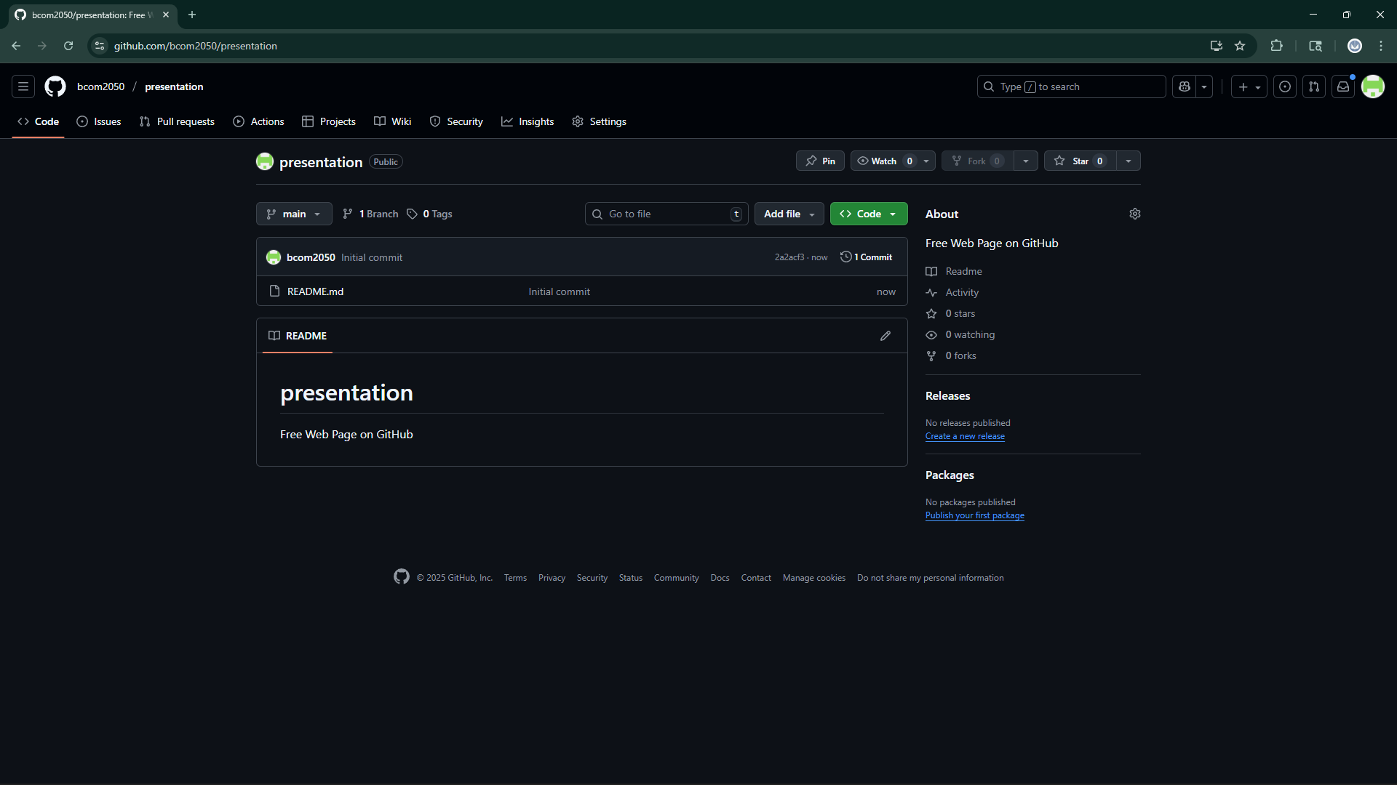

Slide 12
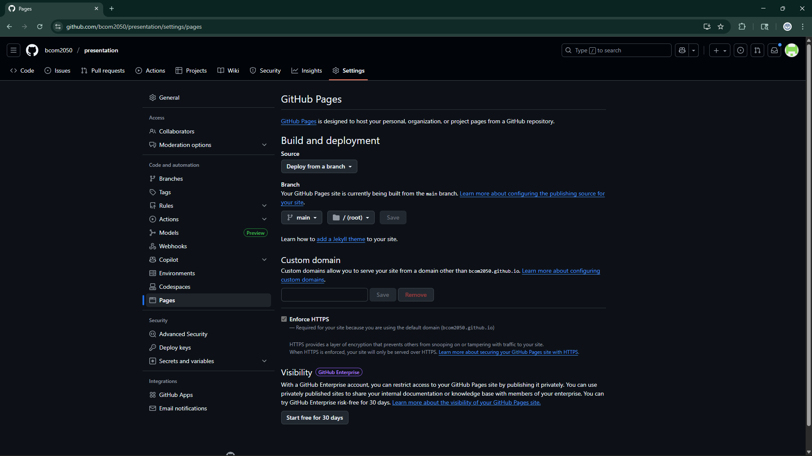

Slide 13
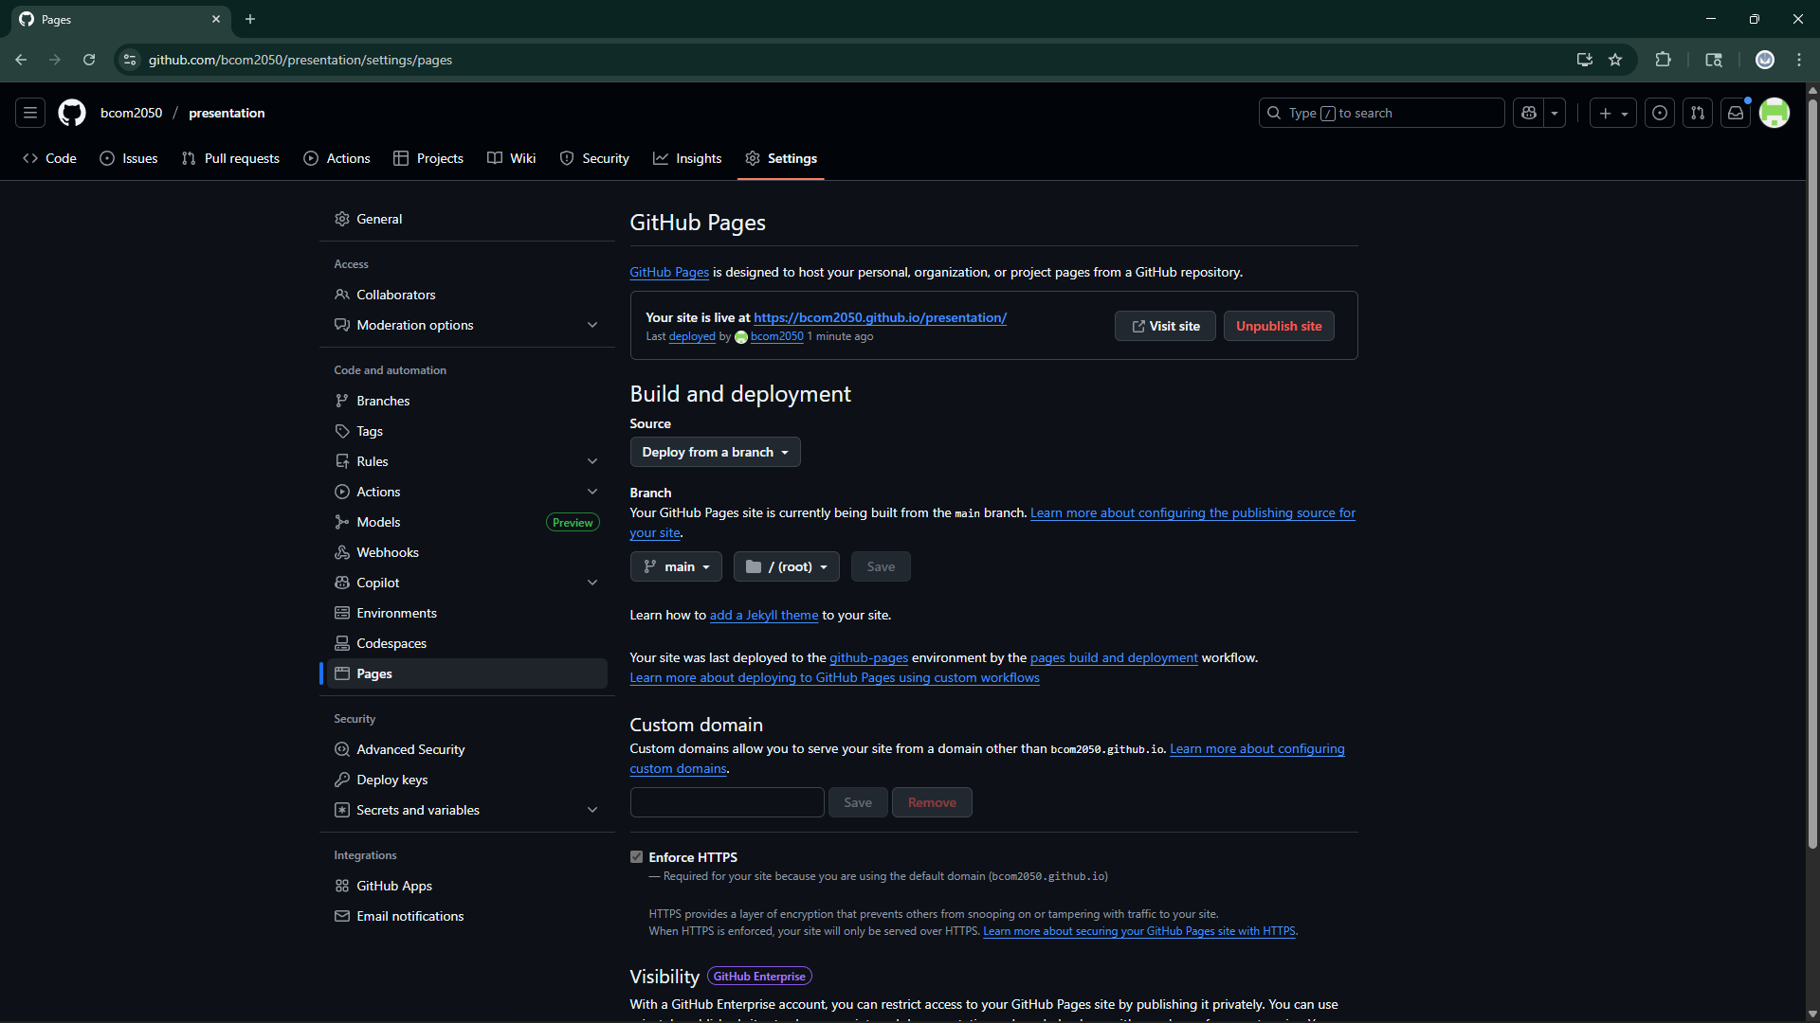

Slide 14
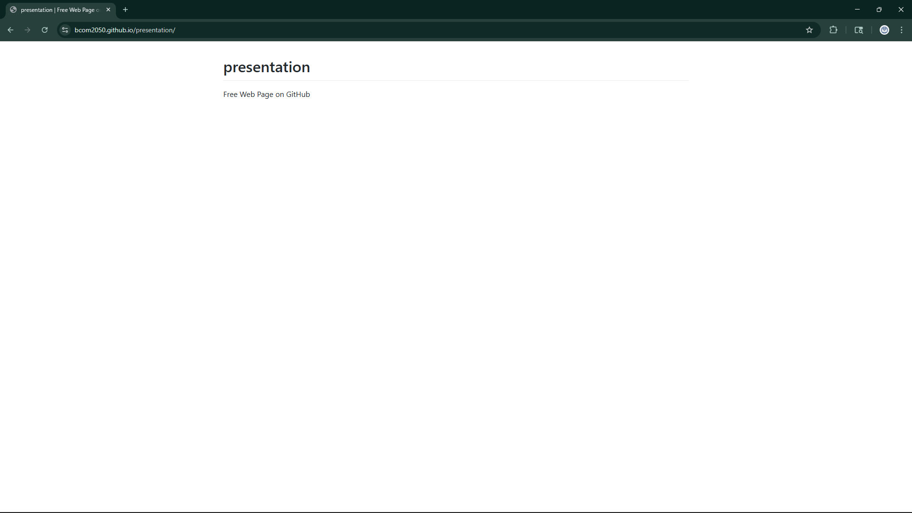

Slide 15
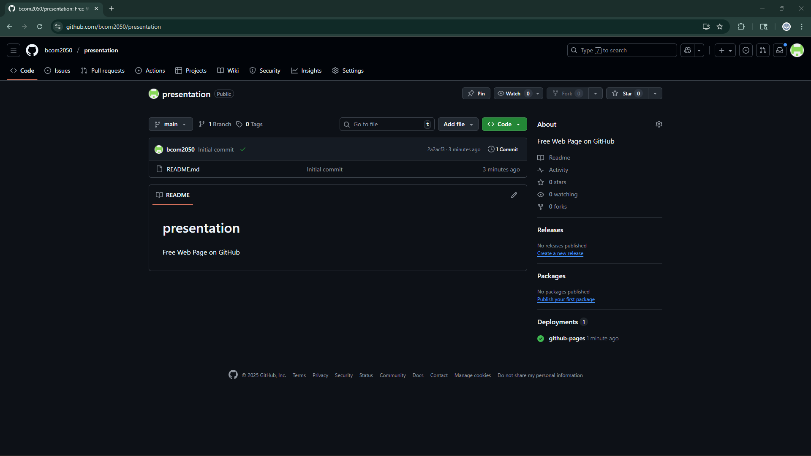

Slide 16
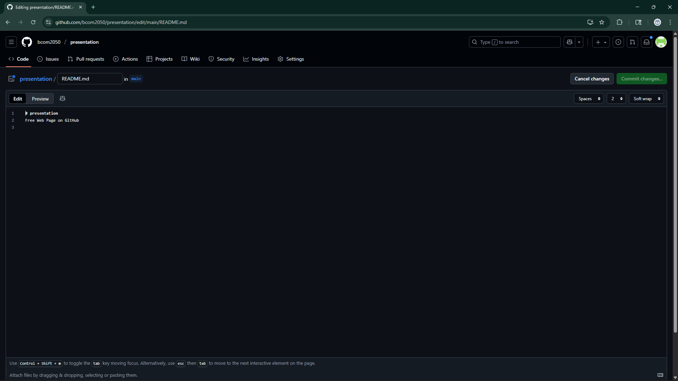

Slide 17
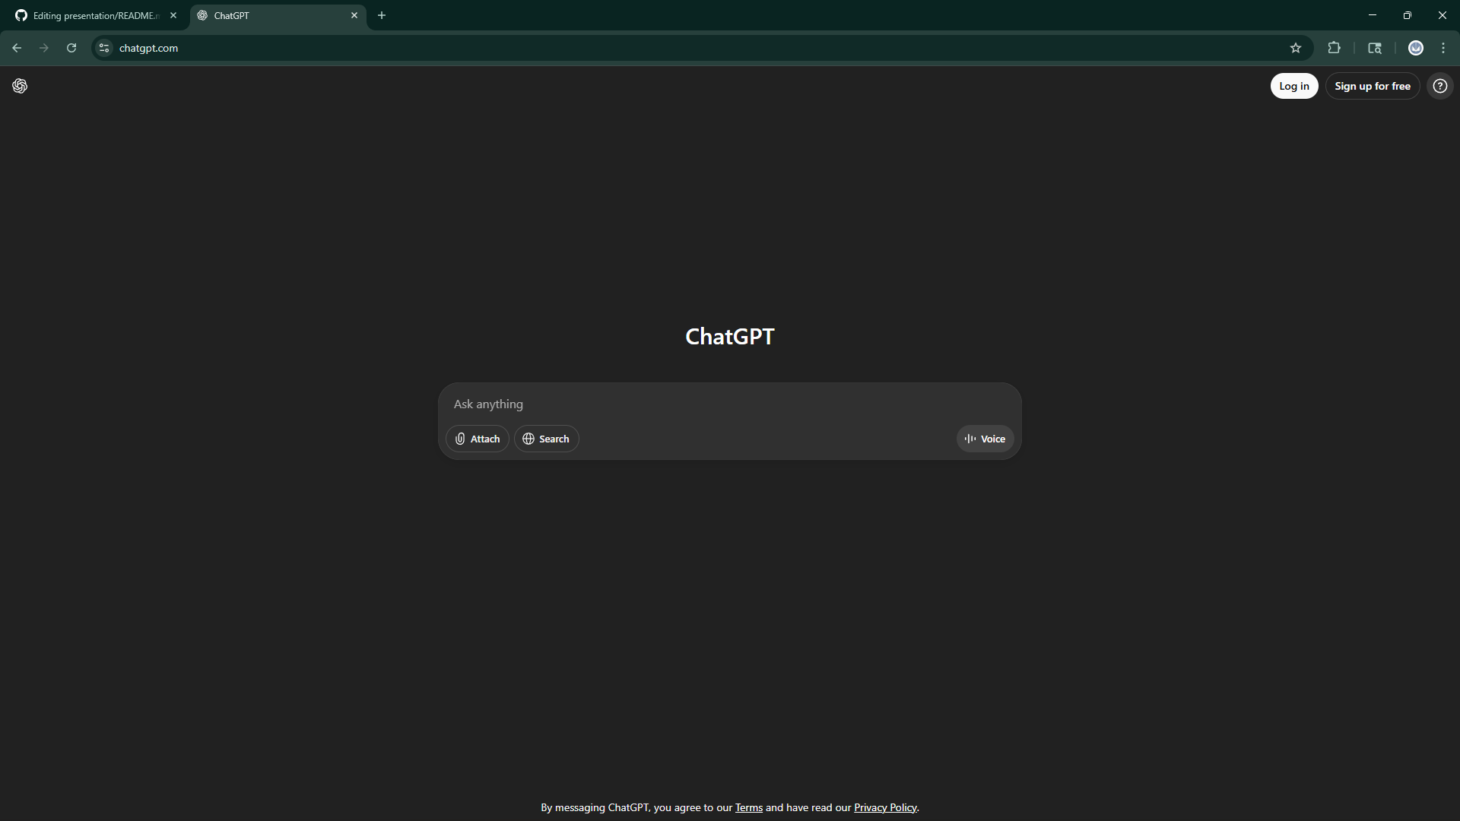

Slide 18
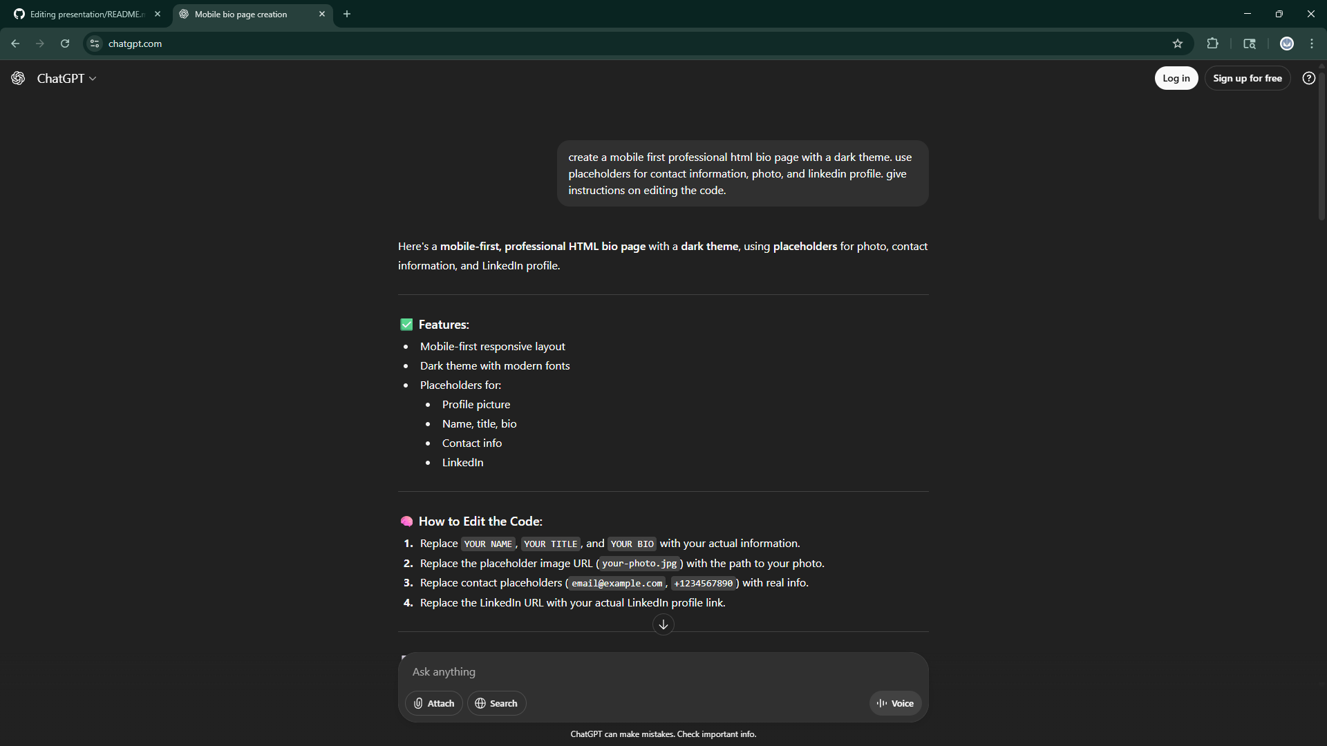

Slide 19
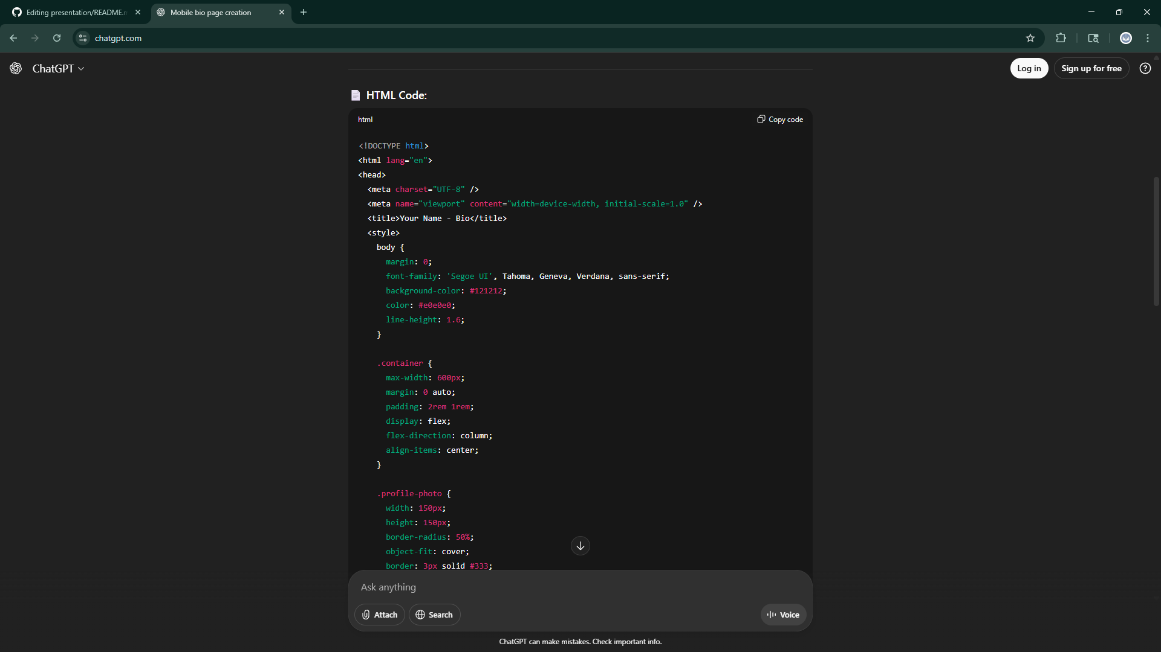

Slide 20
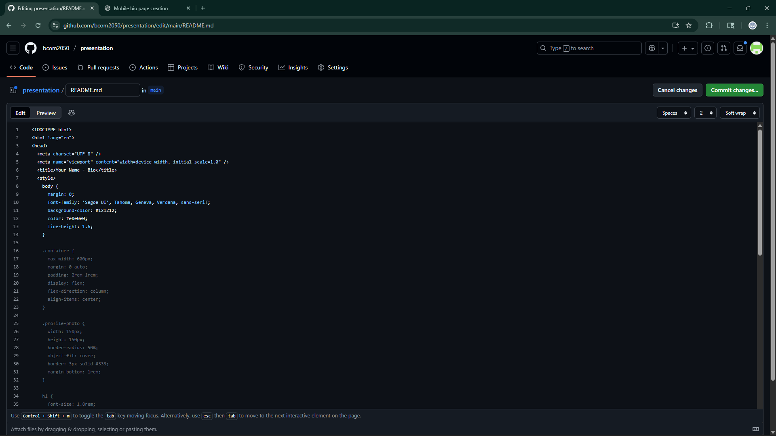

PASTE

Slide 21
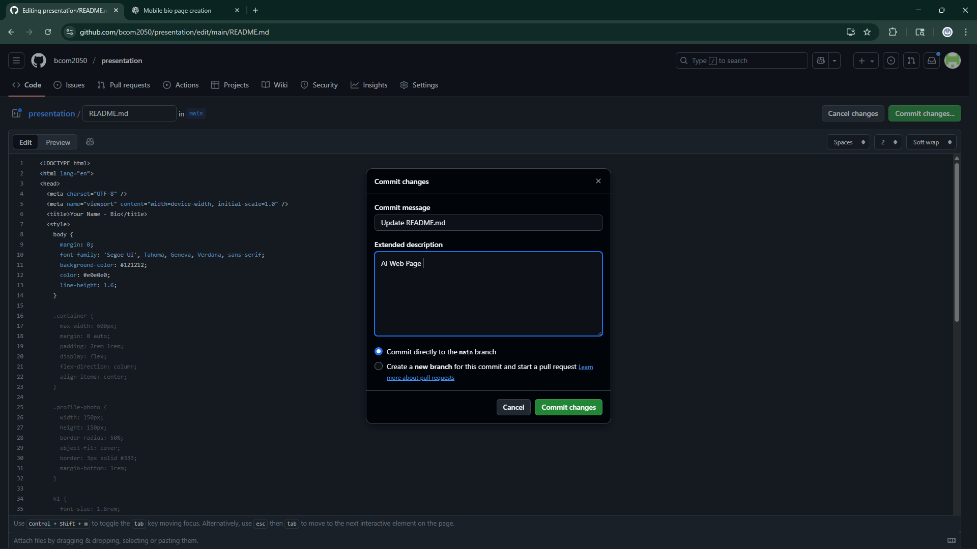

Slide 22
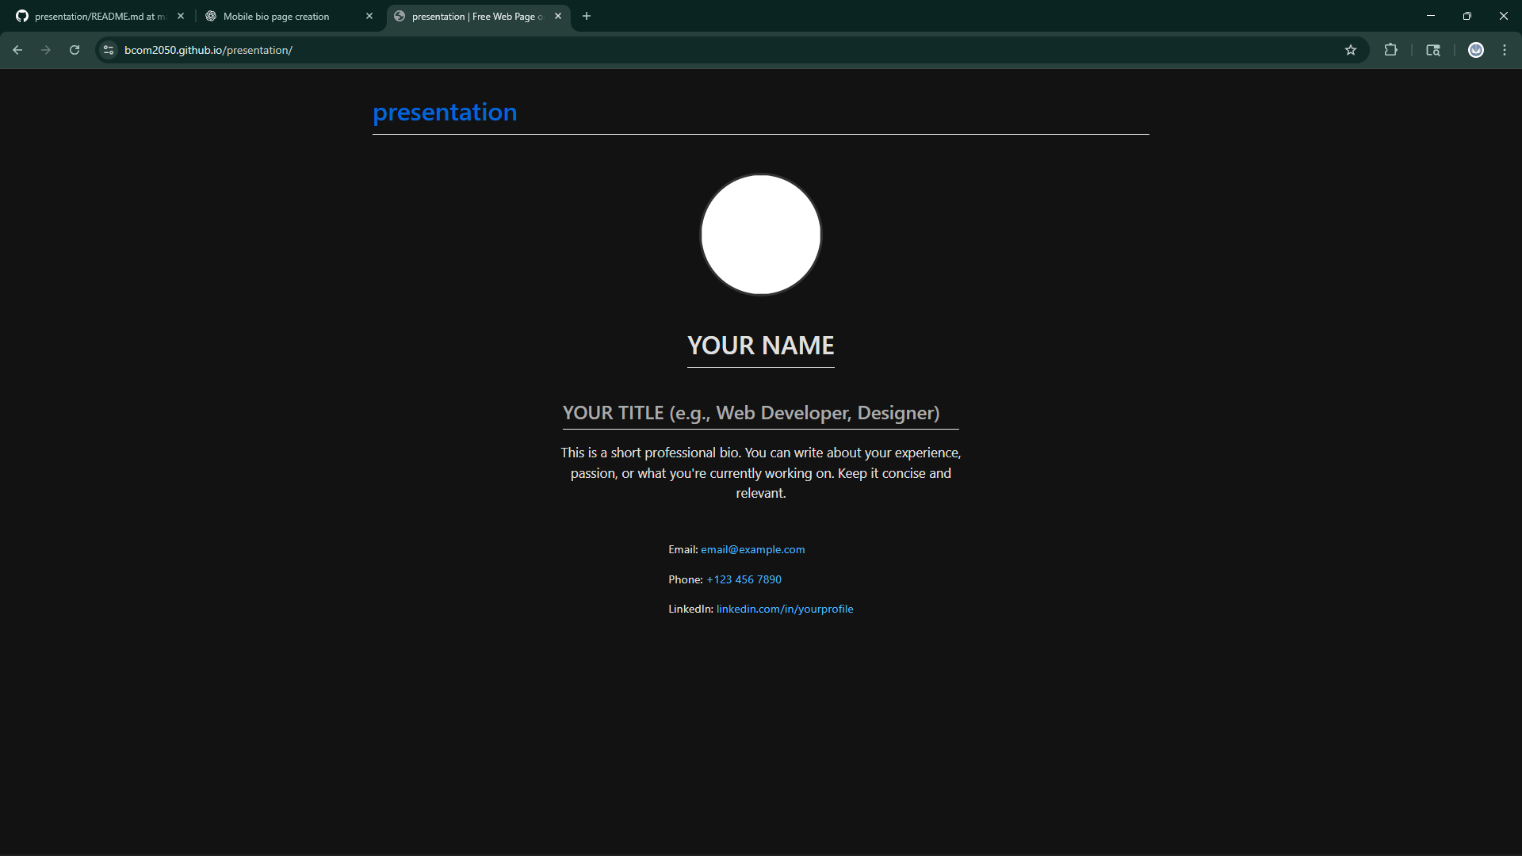

Slide 23
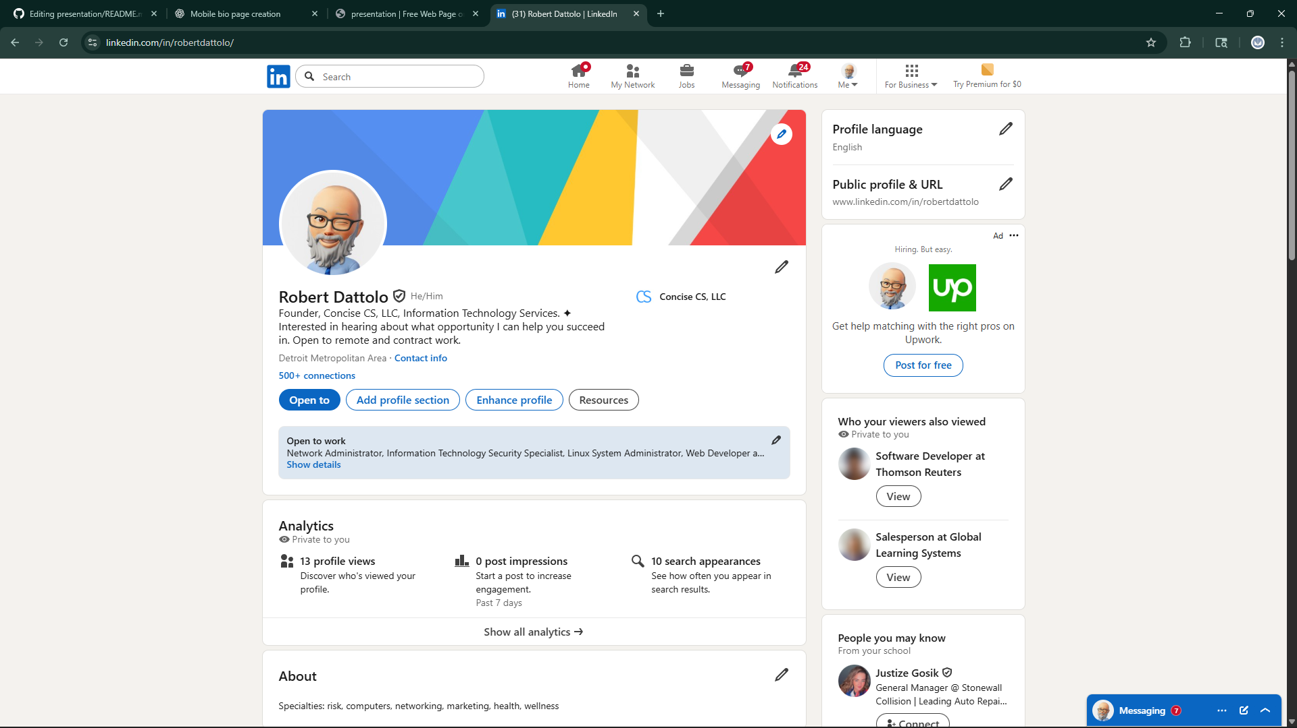
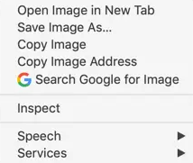

Slide 24
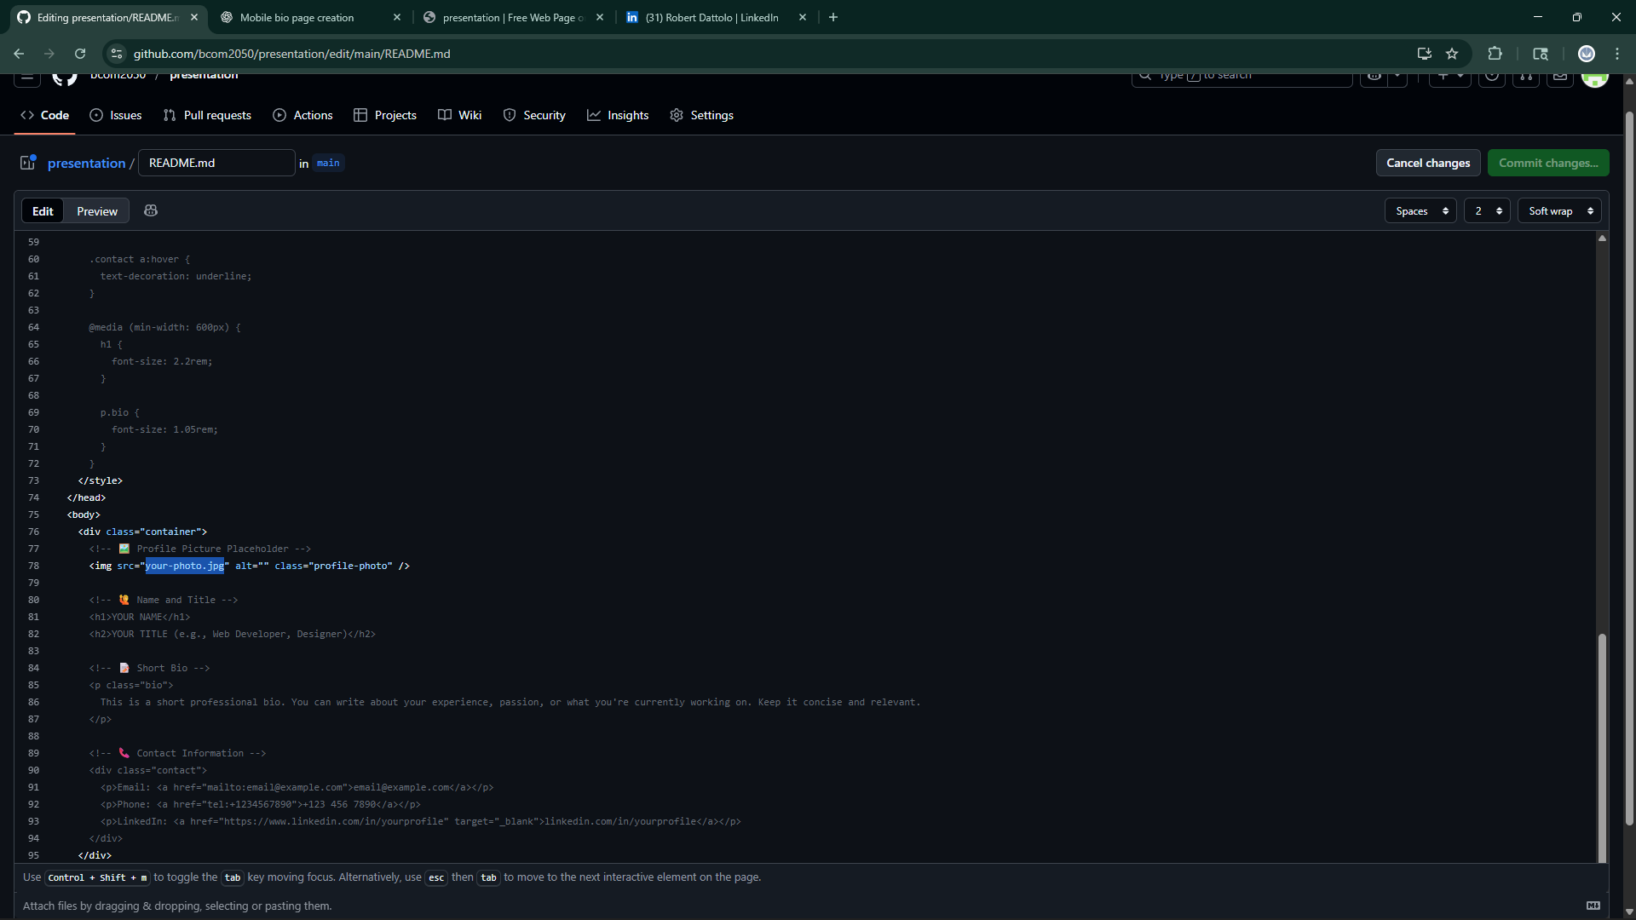

Slide 25
COMMIT CHANGES
Wait for Deployment / Refresh Web Site

Slide 26
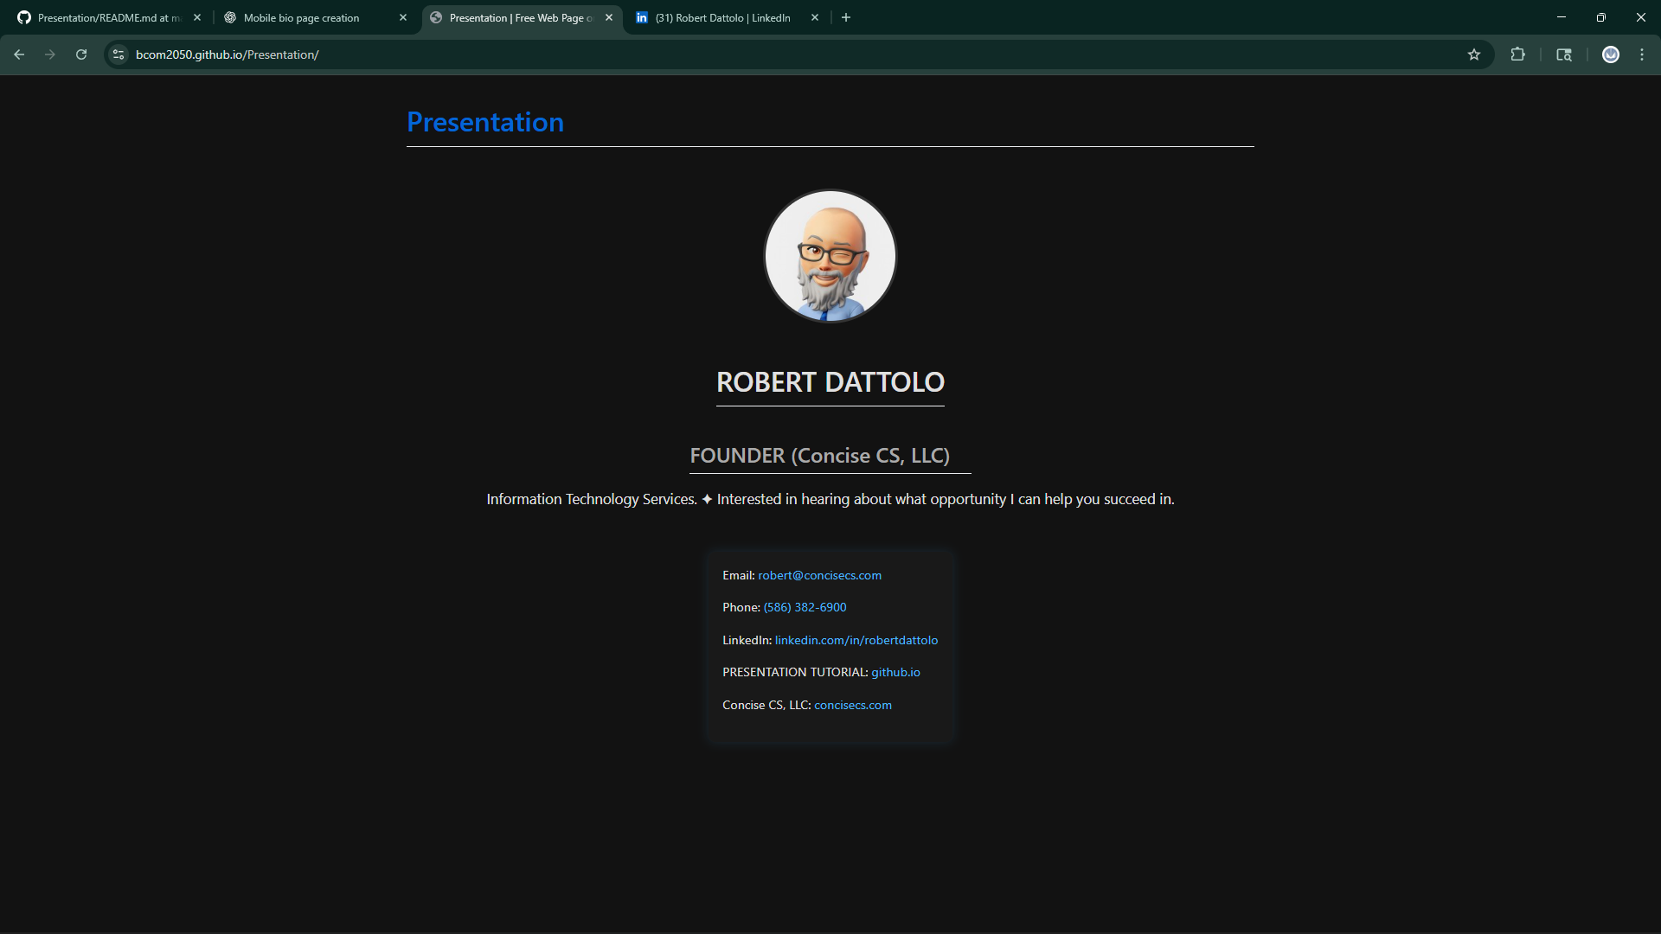

Slide 27
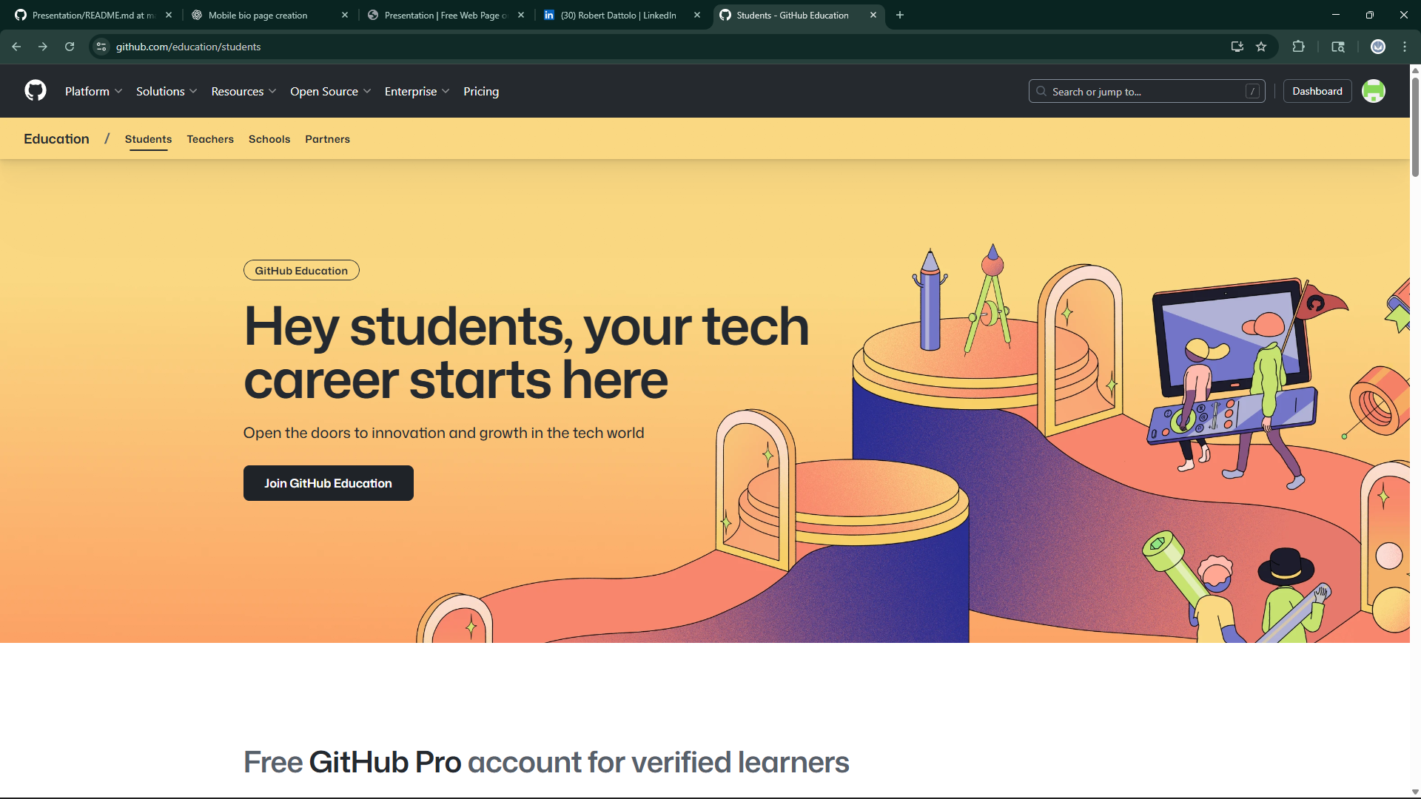

Slide 28
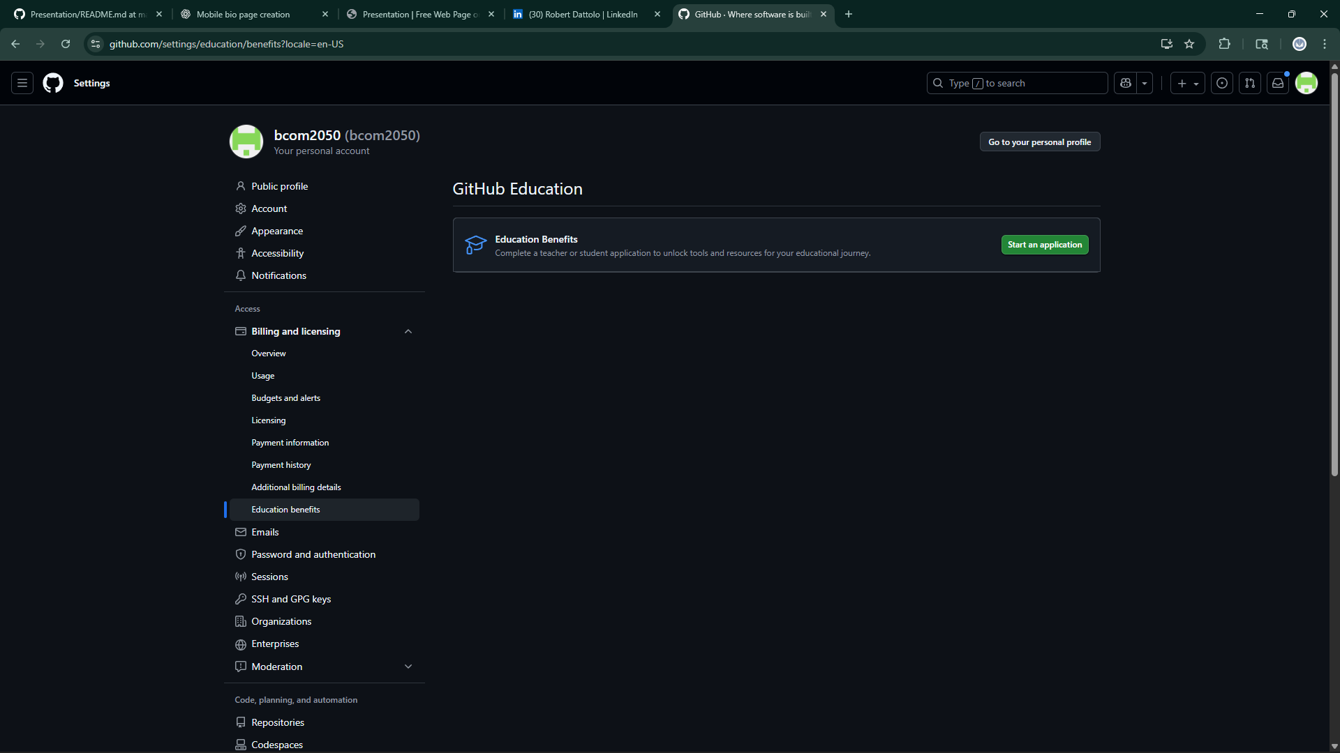

Slide 29
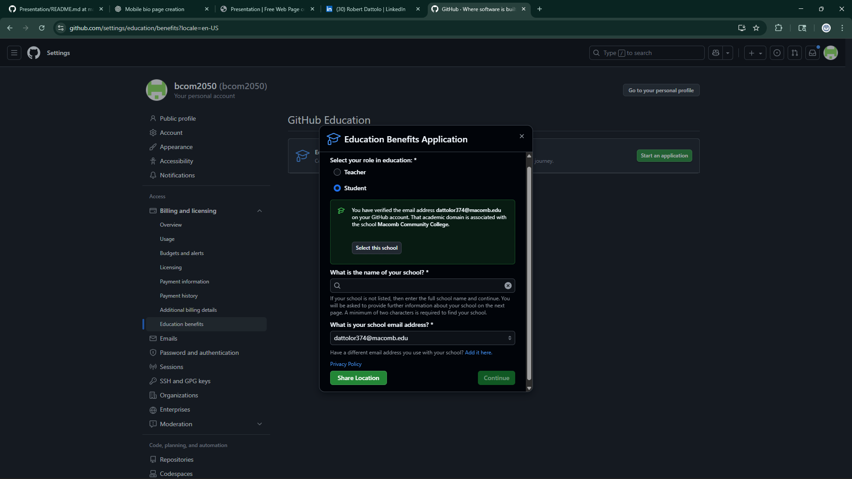

Slide 30
Works Cited
GitHub. Build and Ship Software on a Single, Collaborative Platform. 2025, github.com.
GitHub Pages. 2025, github.io.
“Prompt” ChatGPT, OpenAI, 29 September 2025, chat.openai.com.
Thill, John V., and Courland L. Bovée. Excellence in Business Communication. 13th ed., Pearson, 2020.

Slide 31

